Slide 1
Soft Computing
UNIT -1
Contents -
Introduction to Soft Computing: Define Soft Computing
Characteristics of Soft computing, Example
Applications of soft computing
Need of soft computing
Elements of soft computing
Soft computing vs hard computing

Slide 2
Soft Computing
Soft computing is a collection of artificial intelligence (AI) computing techniques that gives devices human-like problem-solving capabilities. It includes the basics of neural networks, fuzzy logic, and genetic algorithms.
The soft computing theory and techniques were introduced in the 1980s. The term was coined by Lofti A. Zadeh, a mathematician, computer scientist, electrical engineer, AI researcher, and professor emeritus of computer science at the University of California, Berkeley.

Slide 3
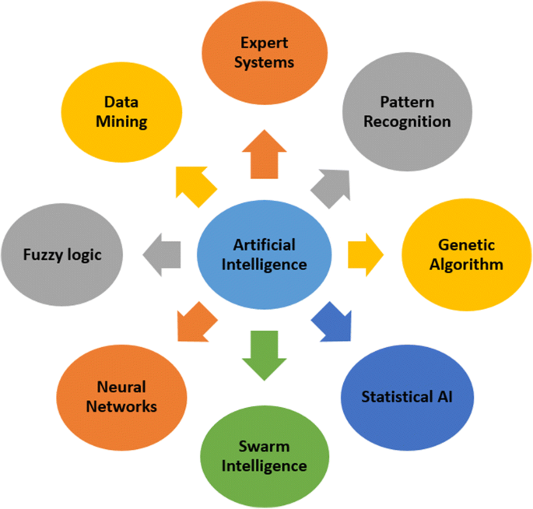
Soft Computing Techniques -

Slide 4
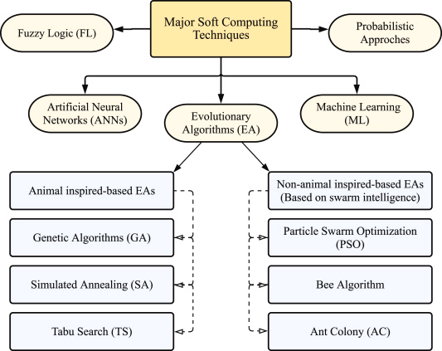
Soft Computing Techniques -

Slide 5
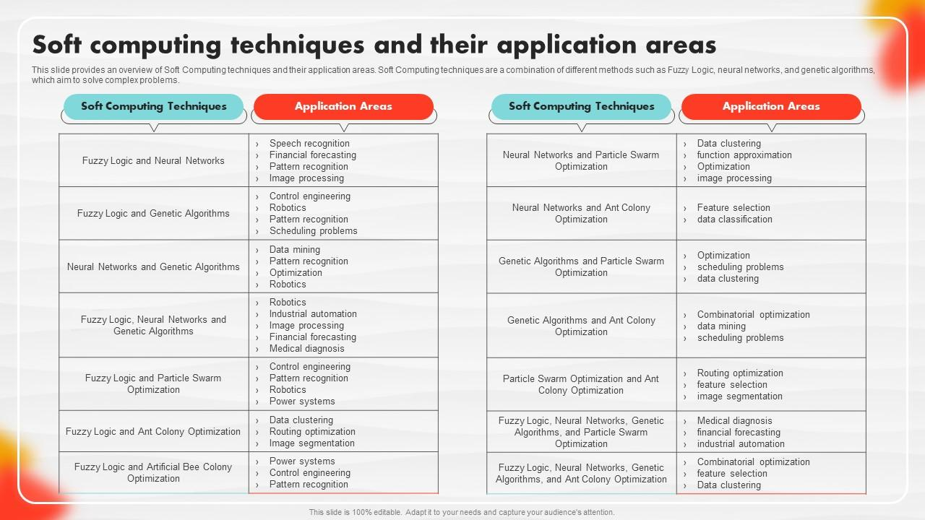
Soft Computing

Slide 6
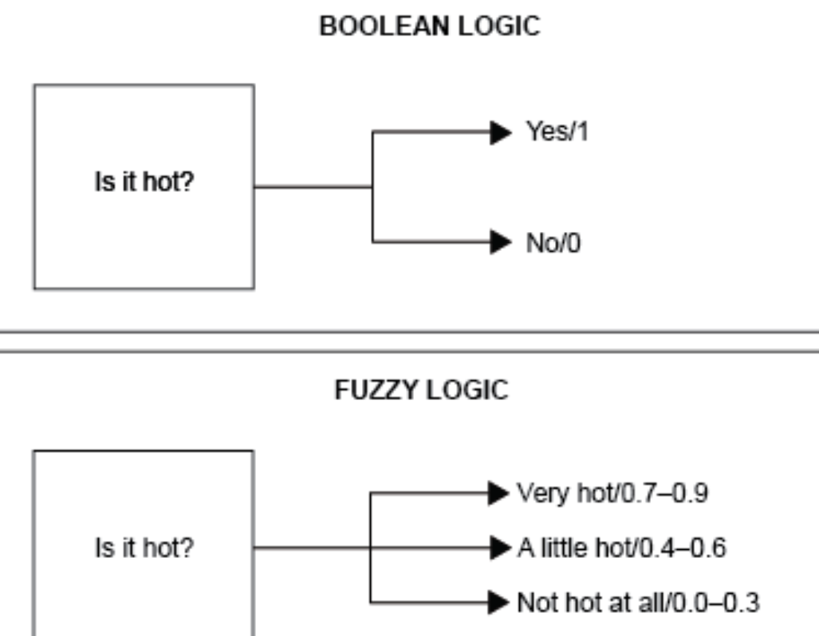
Soft Computing
Fuzzy Logic
Fuzzy logic is a computing approach that relies on “degrees of truth” rather than “true or false” (1 or 0) Boolean logic, which most computers use. Zadeh introduced the concept in the 1960s, two decades before soft computing.

Slide 7
Genetic Algorithms
Genetic algorithms refer to a group of search methods that are inspired by the theory of evolution. As such, they create sets of solutions that evolve to get the lowest or highest value of an objective function or a linear expression. In math, that’s the formula you are given, such as f = c1x1 + … + cnxn. They help obtain all the values that would possibly result given a specific objective function.
Artificial Neural Networks
An artificial neural network is a computer program that emulates a particular biological counterpart. A machine designed to work as a human heart is an example of an artificial neural network. It uses trial and error to get to the desired output.
At present, artificial neural networks are already used to spot fraudulent transactions, recognize people in photographs, predict outcomes, recognize speech and natural language, and more.

Slide 8
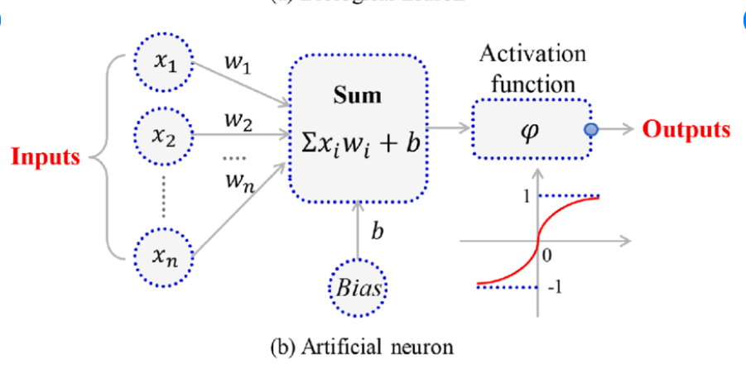
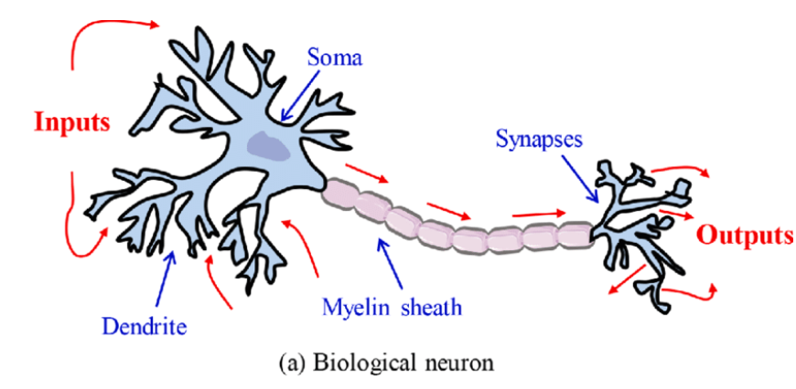
Artificial Neural Networks

Slide 9
Machine Learning
Machine learning (ML) is an AI branch that develops computers that learn and improve from experience without any human intervention or programming. Machines are fed tons of data, which they analyze for patterns and learn from using examples. Over time, they automatically make decisions and adjust actions accordingly.
Expert Systems
An expert system is a computer or application that provides answers, solves complex problems, and makes decisions just like a human expert in a specialized domain. It performs complex calculations, analyses, and predictions and so is considered the first successful AI model.

Slide 10
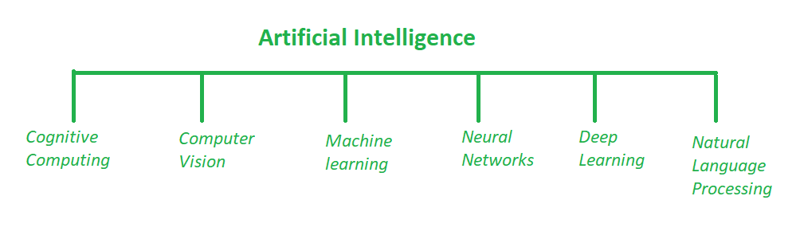
Difference between AI and Soft Computing
Artificial Intelligence:
AI manages more comprehensive issues of automating a system. This computerization should be possible by utilizing any field such as image processing, cognitive science, neural systems, machine learning etc. AI manages the making of machines, frameworks and different gadgets savvy by enabling them to think and do errands as all people generally do.

Slide 11
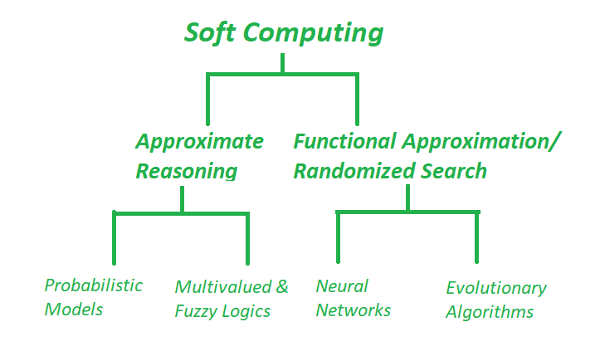
Soft Computing:
Soft Computing could be a computing model evolved to resolve the non-linear issues that involve unsure, imprecise and approximate solutions of a tangle. These sorts of issues square measure thought of as real-life issues wherever the human-like intelligence is needed to resolve it.

Slide 12
Difference between AI and Soft Computing
S.NO. | A.I. | SOFT COMPUTING
1 | Artificial Intelligence is the art and science of developing intelligent machines. | Soft Computing aims to exploit tolerance for uncertainty, imprecision, and partial truth.
2 | AI plays a fundamental role in finding missing pieces between the interesting real world problems. | Soft Computing comprises techniques which are inspired by human reasoning and have the potential in handling imprecision, uncertainty and partial truth.
3 | Branches of AI : | Branches of soft computing :
4 | AI has countless applications in healthcare and widely used in analyzing complicated medical data. | They are used in science and engineering disciplines such as data mining, electronics, automotive, etc.

Slide 13
Difference between AI and Soft Computing
5 | Goal is to stimulate human-level intelligence in machines. | It aims at accommodation with the pervasive imprecision of the real world.
6 | They require programs to be written. | They not require all programs to be written, they can evolve its own programs.
7 | They require exact input sample. | They can deal with ambiguous and noisy data.
8 | Artificial Intelligence mainly deals with making the machines intelligent. | Soft computing mainly deals with the imprecision and probabilities.
9 | AI is also used to solve problems that is at the human level like pattern identification, problem resolution, plan execution, automating analytical jobs, detecting efficiencies and performance enhancement. | Soft computing solves the complicated real-world situations to bring better solutions that some researchers cannot quantitatively describe.

Slide 14
Need for Soft Computing
The need for soft computing arises from the limitations of traditional, classical computing methods in solving real-world problems. Soft computing is a branch of artificial intelligence that provides approximate solutions to complex problems that are difficult or impossible to solve using classical methods.
The following are some of the reasons why soft computing is needed:
1. Complexity of real-world problems: Many real-world problems are complex and involve uncertainty, vagueness, and imprecision. Traditional computing methods are not well-suited to handle these complexities.

Slide 15
Need for Soft Computing
The following are some of the reasons why soft computing is needed:
2. Incomplete information: In many cases, there is a lack of complete and accurate information available to solve a problem. Soft computing techniques can provide approximate solutions even in the absence of complete information.
3. Noise and uncertainty: Real-world data is often noisy and uncertain, and classical methods can produce incorrect results when dealing with such data. Soft computing techniques are designed to handle uncertainty and imprecision.
4. Non-linear problems: Many real-world problems are non-linear, and classical methods are not well-suited to solve them. Soft computing techniques such as fuzzy logic and neural networks can handle non-linear problems effectively.

Slide 16
Need for Soft Computing
The following are some of the reasons why soft computing is needed:
5. Human-like reasoning: Soft computing techniques are designed to mimic human-like reasoning, which is often more effective in solving complex problems.
Overall, soft computing provides an effective and efficient way to solve complex real-world problems that are difficult or impossible to solve using classical computing methods.

Slide 17
Concept of computing :
According to the concept of computing, the input is called an antecedent and the output is called the consequent. For example, Adding information in DataBase, Compute the sum of two numbers using a C program, etc.​
There are two types of computing as following :
Hard computing
Soft computing

Slide 18
Concept of computing :
Characteristics of hard computing :
The precise result is guaranteed​.
The control action is unambiguous​.
The control action is formally defined (i.e. with a mathematical model)

Slide 19
Concept of computing :
Characteristics of soft computing :
It may not yield a precise solution​.
Algorithms are adaptive.
In soft computing, you can consider an example where you can see the evolution changes for a specific species like the human nervous system and behavior of an Ant's, etc.
Learning from experimental data.

Slide 20
Difference between Soft Computing and Hard Computing
The main difference between Soft Computing and Hard Computing is their approach to solving complex problems:
1. Hard Computing:
Hard computing uses traditional mathematical methods to solve problems, such as algorithms and mathematical models.
It is based on deterministic and precise calculations and is ideal for solving problems that have well-defined mathematical solutions.

Slide 21
Difference between Soft Computing and Hard Computing
1. Hard Computing:
Hard Computing is that the ancient approach employed in computing that desires Associate in Nursing accurately declared analytical model.
The outcome of hard computing approach is a warranted, settled, correct result and defines definite management actions employing a mathematical model or algorithmic rule.
It deals with binary and crisp logic that need the precise input file consecutive. Hard computing isn't capable of finding the real world problem's solution.

Slide 22
Difference between Soft Computing and Hard Computing
2. Soft Computing:
Soft computing, on the other hand, uses techniques such as fuzzy logic, neural networks, genetic algorithms, and other heuristic methods to solve problems.
It is based on the idea of approximation and is ideal for solving problems that are difficult or impossible to solve exactly.
Soft Computing could be a computing model evolved to resolve the non-linear issues that involve unsure, imprecise and approximate solutions of a tangle. These sorts of issues square measure thought of as real-life issues wherever the human-like intelligence is needed to resolve it.

Slide 23
Difference between Soft Computing and Hard Computing
Sr.No | Soft Computing | Hard Computing
1. | Soft Computing is liberal of inexactness, uncertainty, partial truth and approximation. | Hard computing needs a exactly state analytic model.
2. | Soft Computing relies on formal logic and probabilistic reasoning. | Hard computing relies on binary logic and crisp system.
3. | Soft computing has the features of approximation and dispositionality. | Hard computing has the features of exactitude(precision) and categoricity.

Slide 24
Difference between Soft Computing and Hard Computing
4. | Soft computing is stochastic in nature. | Hard computing is deterministic in nature.
5. | Soft computing works on ambiguous and noisy data. | Hard computing works on exact data.
6. | Soft computing can perform parallel computations. | Hard computing performs sequential computations.
7. | Soft computing produces approximate results. | Hard computing produces precise results.

Slide 25
Difference between Soft Computing and Hard Computing
8. | Soft computing will emerge its own programs. | Hard computing requires programs to be written.
9. | Soft computing incorporates randomness . | Hard computing is settled.
10. | Soft computing will use multivalued logic. | Hard computing uses two-valued logic.

Slide 26
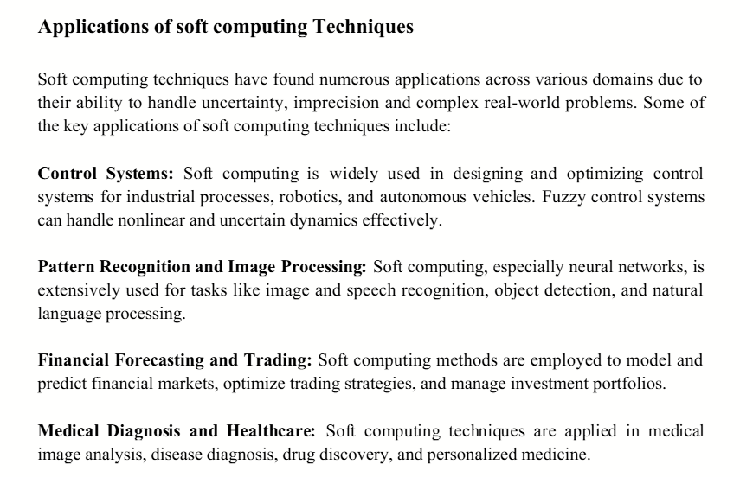
Application of Soft Computing

Slide 27
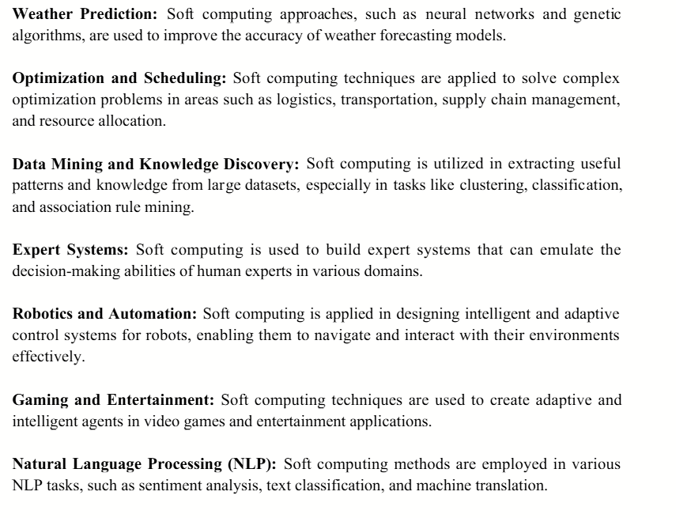

Slide 28
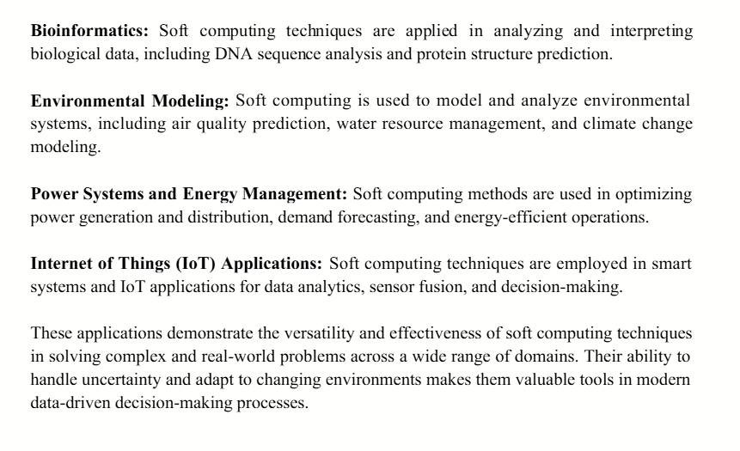

Slide 29
Core Components of Soft Computing -
Genetic Algorithm -
Genetic Algorithms(GAs) are adaptive heuristic search algorithms that belong to the larger part of evolutionary algorithms.
Genetic algorithms are based on the ideas of natural selection and genetics. These are intelligent exploitation of random searches provided with historical data to direct the search into the region of better performance in solution space.
They are commonly used to generate high-quality solutions for optimization problems and search problems.

Slide 30
Genetic algorithms simulate the process of natural selection which means those species that can adapt to changes in their environment can survive and reproduce and go to the next generation.
In simple words, they simulate “survival of the fittest” among individuals of consecutive generations to solve a problem.
Each generation consists of a population of individuals and each individual represents a point in search space and possible solution.
Each individual is represented as a string of character/integer/float/bits. This string is analogous to the Chromosome.

Slide 31
Foundation of Genetic Algorithms
Genetic algorithms are based on an analogy with the genetic structure and behavior of chromosomes of the population. Following is the foundation of GAs based on this analogy -
Individuals in the population compete for resources and mate.
Those individuals who are successful (fittest) then mate to create more offspring than others.
Genes from the “fittest” parent propagate throughout the generation, that is sometimes parents create offspring which is better than either parent.
Thus each successive generation is more suited for their environment.

Slide 32
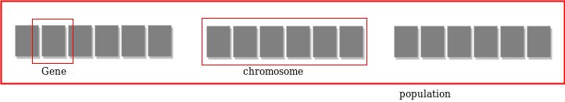
Search space
The population of individuals are maintained within search space.
Each individual represents a solution in search space for given problem.
Each individual is coded as a finite length vector (analogous to chromosome) of components.
These variable components are analogous to Genes.
Thus a chromosome (individual) is composed of several genes (variable components).

Slide 33
Fitness Score
A Fitness Score is given to each individual which shows the ability of an individual to “compete”.
The individual having optimal fitness score (or near optimal) are sought.
The GAs maintains the population of n individuals (chromosome/solutions) along with their fitness scores.
The individuals having better fitness scores are given more chance to reproduce than others.

Slide 34
The individuals with better fitness scores are selected who mate and produce better offspring by combining chromosomes of parents.
The population size is static so the room has to be created for new arrivals.
So, some individuals die and get replaced by new arrivals eventually creating new generation when all the mating opportunity of the old population is exhausted.
It is hoped that over successive generations better solutions will arrive while least fit die.
Each new generation has on average more “better genes” than the individual (solution) of previous generations.
Thus each new generations have better “partial solutions” than previous generations.

Slide 35
Once the offspring produced having no significant difference from offspring produced by previous populations, the population is converged. The algorithm is said to be converged to a set of solutions for the problem.
Operators of Genetic Algorithms
Once the initial generation is created, the algorithm evolves the generation using following operators -
1) Selection Operator:
The idea is to give preference to the individuals with good fitness scores and allow them to pass their genes to successive generations.

Slide 36
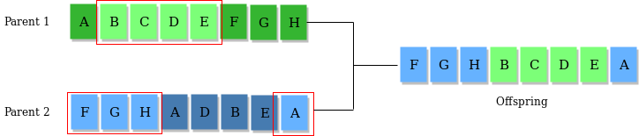
2) Crossover Operator:
This represents mating between individuals. Two individuals are selected using selection operator and crossover sites are chosen randomly. Then the genes at these crossover sites are exchanged thus creating a completely new individual (offspring). For example -

Slide 37
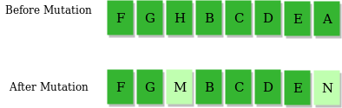
3) Mutation Operator:
The key idea is to insert random genes in offspring to maintain the diversity in the population to avoid premature convergence. For example -
The whole algorithm can be summarized as -

Slide 38
1) Randomly initialize populations p
2) Determine fitness of population
3) Until convergence repeat:
a) Select parents from population
b) Crossover and generate new population
c) Perform mutation on new population
d) Calculate fitness for new population

Slide 39
Why use Genetic Algorithms
They are Robust
Provide optimisation over large space state.
Unlike traditional AI, they do not break on slight change in input or presence of noise .

Slide 40
Application of Genetic Algorithms
Genetic algorithms have many applications, some of them are -
Recurrent Neural Network
Mutation testing
Code breaking
Filtering and signal processing
Learning fuzzy rule base etc

Slide 41
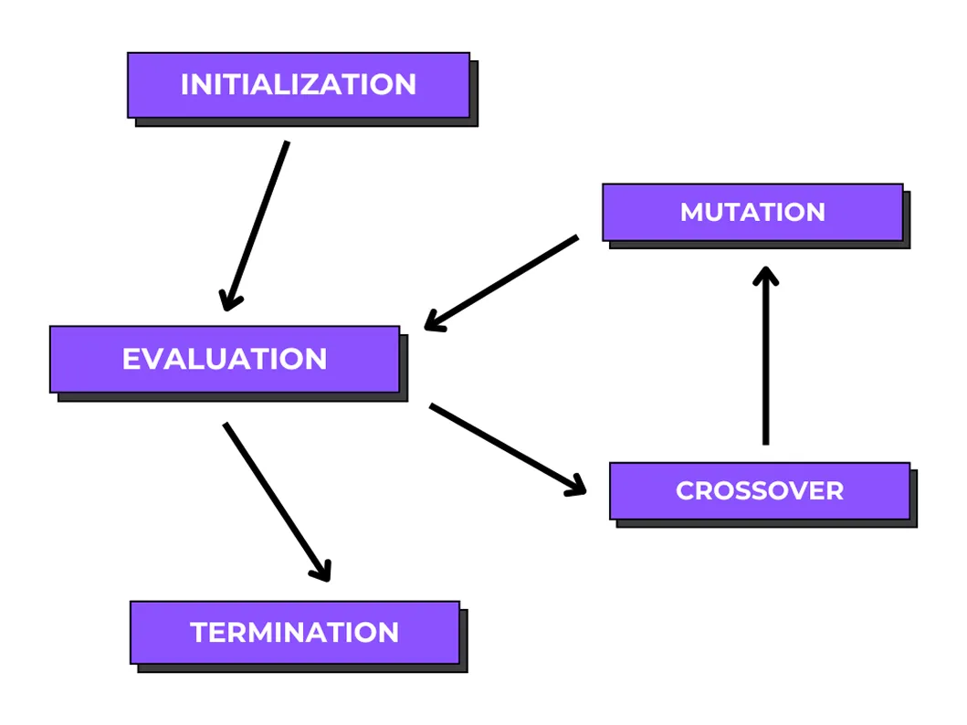
Evolutionary Algorithm

Slide 42
Key Definition
Initialization: Start with a random population of potential solutions (individuals).
Fitness Evaluation: Each solution is tested (its "fitness") to see how good it is.
Selection: Better-fit individuals are chosen as "parents" for the next generation (survival of the fittest).
Crossover (Recombination): Parents' characteristics (genes) are combined to create new "offspring" solutions.
Mutation: Small, random changes are introduced into offspring to create new diversity.
Replacement: The new generation replaces the old one, and the cycle repeats, improving the population's average fitness over time.

Slide 43
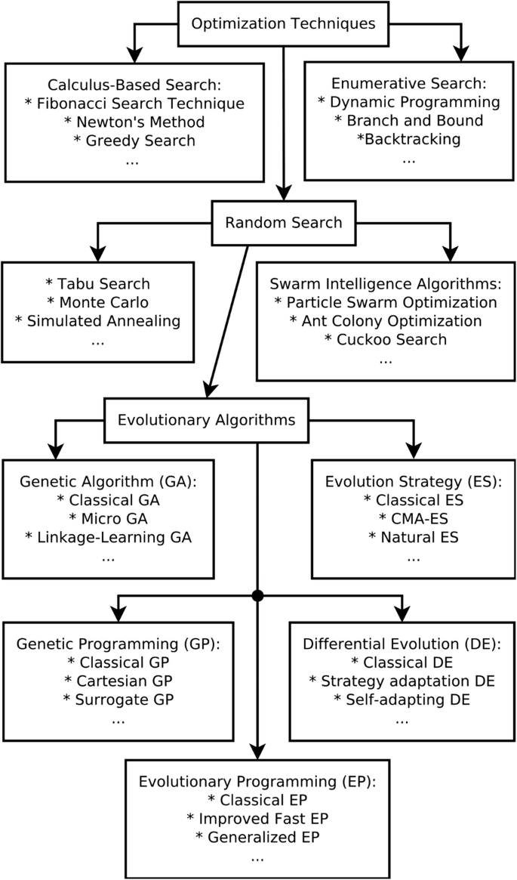
Definition - EA
Evolutionary Algorithms are a class of population-based, stochastic optimization techniques inspired by the principles of natural evolution, such as selection, mutation, and reproduction.
They are used to find optimal or near-optimal solutions to complex problems where traditional methods fail.

Slide 44
Biological Inspiration
EAs are based on Darwin’s theory of evolution, which includes:
Survival of the fittest
Natural selection
Genetic variation
Inheritance of traits

Slide 45
Key Characteristics
Operate on a population of solutions
Use fitness function to evaluate solutions
Employ probabilistic operators
Do not require gradient information
Suitable for nonlinear, multimodal, and NP-hard problems

Slide 46
Basic Components of Evolutionary Algorithms
1. Representation (Chromosome)
A solution is encoded as a chromosome
Common representations:
Binary
Real-valued
Permutation
Tree-based (for Genetic Programming)

Slide 47
2. Population
A set of chromosomes
Provides diversity for exploration
3. Fitness Function
Measures the quality of a solution
Guides the evolution process
4. Genetic Operators
Selection – chooses fitter individuals
Crossover (Recombination) – combines parents
Mutation – introduces random variations

Slide 48
5. Termination Criteria
Maximum number of generations
Desired fitness achieved
No significant improvement
General Steps of an Evolutionary Algorithm
Initialize population randomly
Evaluate fitness of each individual
Select parents based on fitness
Apply crossover and mutation
Generate new population
Check termination condition
Output best solution

Slide 49
Types of Evolutionary Algorithms
Genetic Algorithms (GA)
Binary or real-coded chromosomes
Uses crossover and mutation
Widely used in optimization
Evolution Strategies (ES)
Real-valued parameters
Focus on mutation
Common in engineering design

Slide 50
Evolutionary Programming (EP)
Emphasizes mutation and selection
No crossover
Genetic Programming (GP)
Programs represented as trees
Used for symbolic regression and program evolution
Advantages of Evolutionary Algorithms
Global search capability
Can handle noisy and dynamic environments
Works with multiple objectives
Easy to parallelize

Slide 51
Limitations
Computationally expensive
No guarantee of optimal solution
Sensitive to parameter tuning
Slower convergence in some cases
Applications
Machine learning and AI
Optimization problems
Robotics and control systems
Scheduling and routing
Feature selection
Game playing

Slide 52
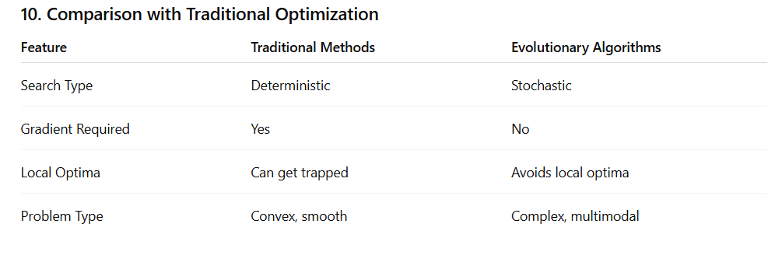
A local optimum is a solution that is better than all its neighboring solutions but not the best solution overall (global optimum).

Slide 53
Thank You

